Slide 1
What are JSON REST APIs?
Donald Cousar
Bellevue University
RESTFul APIs

Slide 2
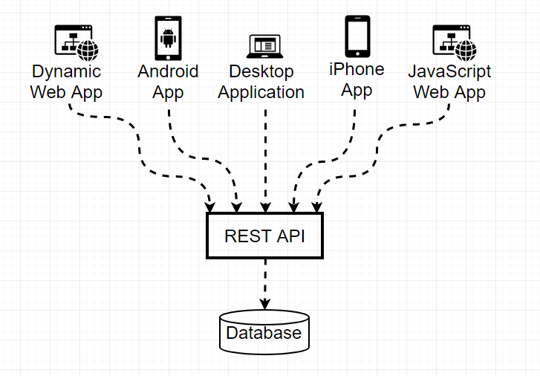
What is a REST API?
A RESTful APIs are a way to expose functionality of your web site through a web service.

Slide 3
What is JSON?
JSON stands for JavaScript Object Notation
JSON is a lightweight format for storing and transporting data
JSON is often used when data is sent from a server to a web page
JSON is "self-describing" and easy to understand
JSON RULES
Data is in name/value pairs
Data is separated by commas
Curly braces hold objects
Square brackets hold arrays

Slide 4
But what's different about SOAP?
SOAP is a protocol.
SOAP uses XML as data format
SOAP has additional overhead as the envelope contains header, body etc.
SOAP defines a strict formal contract through WSDL and XSD’s, REST need not have a strict formal contract.
SOAP defines operations and methods separately
SOAP contains WSDL file which defines a strict contract and contains datatypes and operations

Slide 5
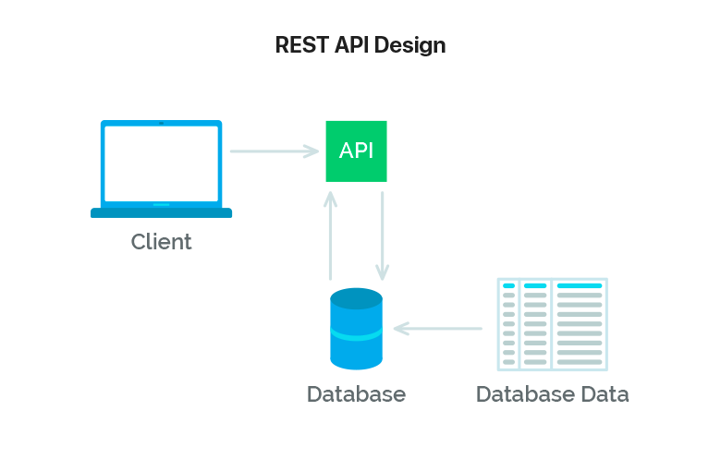
How does API data flow?

Slide 6
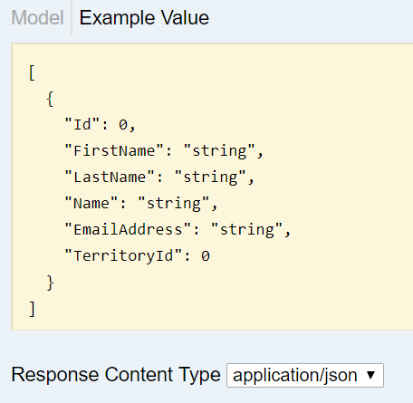
How does JSON look?

Slide 7
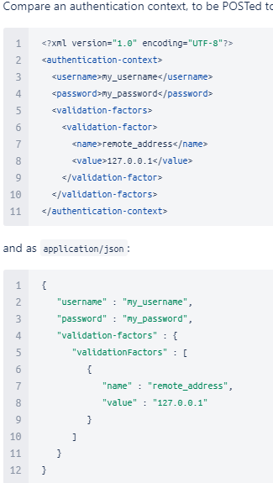
JSON vs XML

Slide 8
JSON Request Headers
The JSON Request Headers and parameters contain a wealth of information that can help you track down issues when you encounter them.
HTTP Headers are an important part of the API request and response as they represent the meta-data associated with the API request and response.
Headers carry information for:
Request and Response Body
Request Authorization
Response Caching
Response Cookies

Slide 9
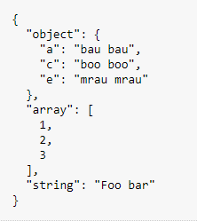
JSON Request Body
The JSON request body contains the details of the request itself.

Slide 10
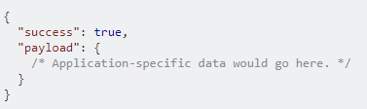
JSON Response Body
The JSON response body contains the results of the of the request, and the data you requested to be returned to you, also known as the payload.

Slide 11
References
Howdle, Ben. Feb 9, 2012. A Beginner's Guide to jQuery-Based JSON. Retrieved from: https://www.smashingmagazine.com/2012/02/beginners-guide-jquery-based-json-api-clients/
Zell. Jan 17, 2018. Understanding and using REST APIs. Retrieved from: https://www.smashingmagazine.com/2018/01/understanding-using-rest-api/

